Slide 2
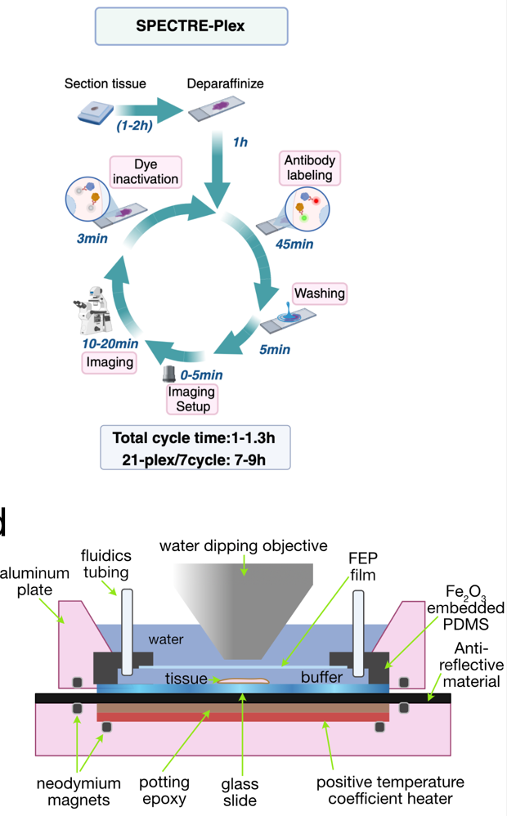
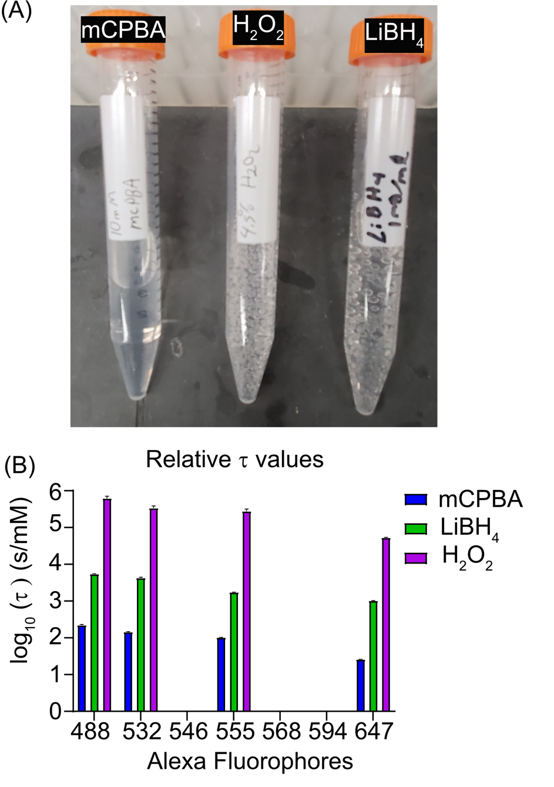
What is the Spectre-Plex?
Implementation of cyclic bleach multiplexing
In brief, builds up stains on tissue by iteratively staining tissue, imaging and bleaching and then restaining with same fluorophores, but different antibodies
Key additions to method: fluidic device that is reusable + aberration free imaging in water and very fast, microfluidic compatible bleach solution

Slide 3
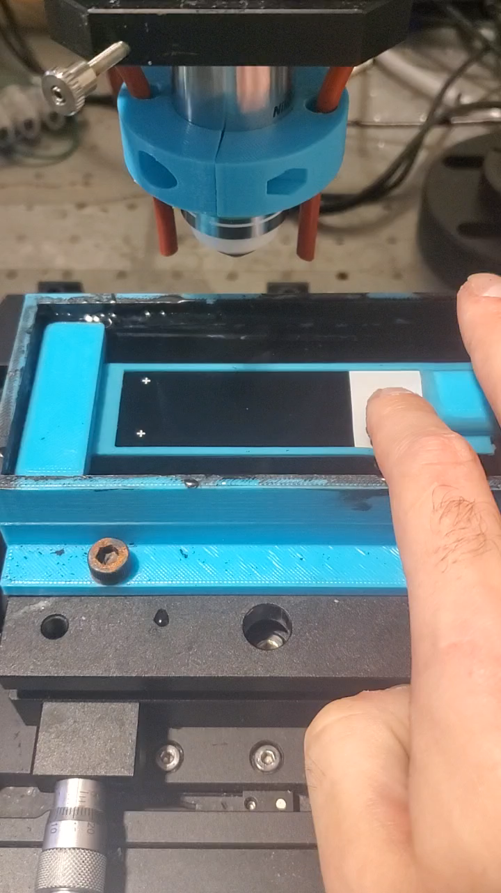
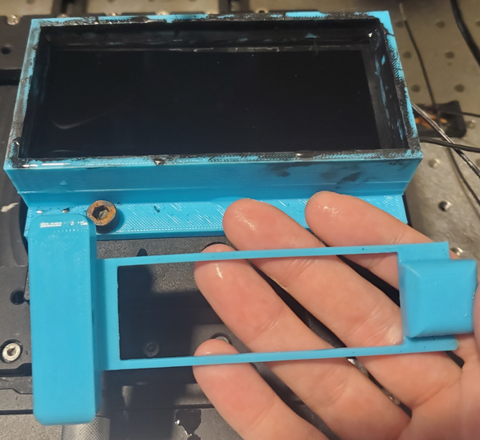
New Chamber for GUT-TAGE
Needed flexibility to place invisi-slip fluidic device anywhere lengthwise on slide
Needed more robust alignment jig, durability and repeatability wise
TMA could be in varied locations

Slide 4
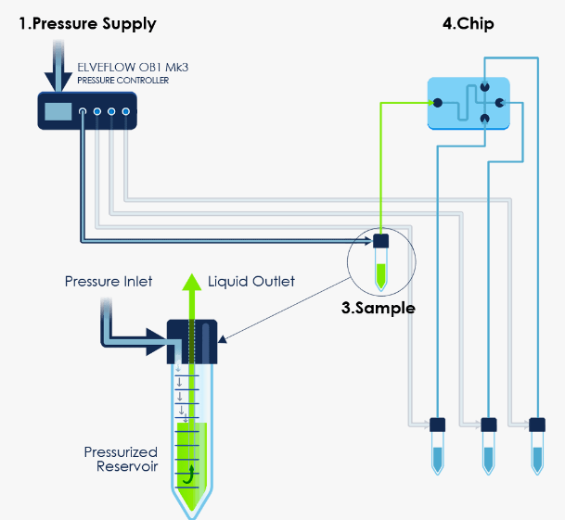

Digital Back Flips for Fluidic System
Unreliability in fluidic system stemming from system freezes and not accepting commands
Python
Resend command
Tell power strip to power cycle OB1
Didn’t respond to command
Frozen Flow meter
Plugged into smart power strip

Slide 5
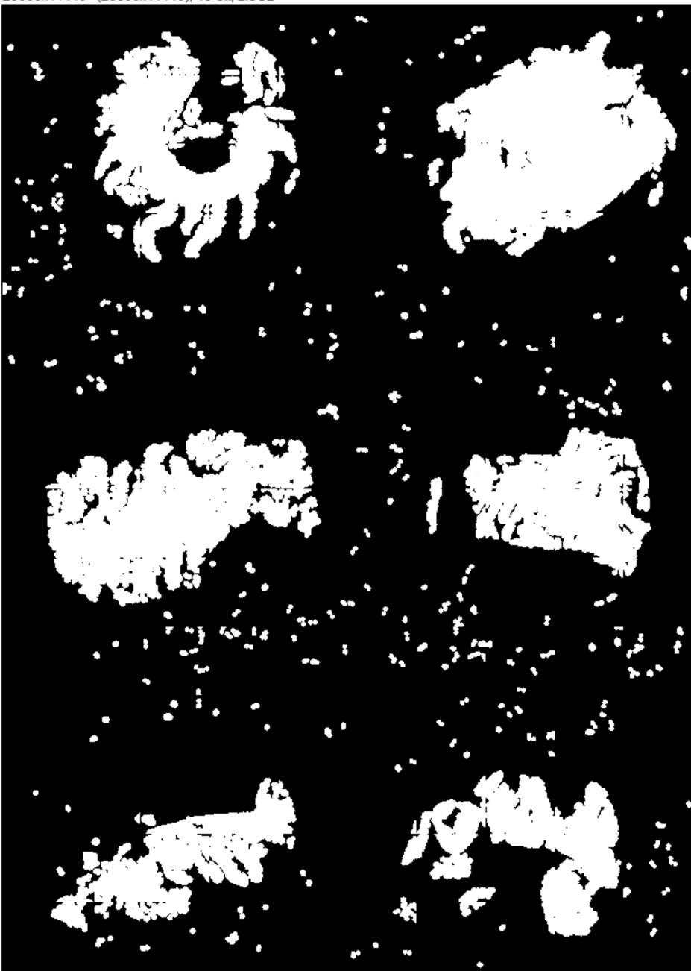

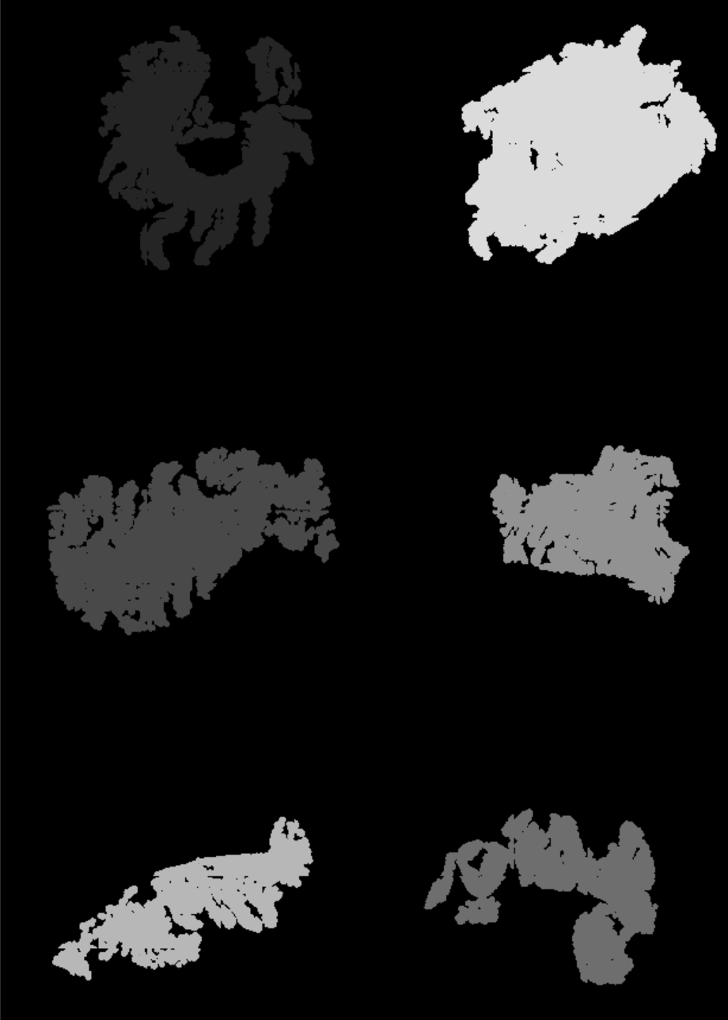
Cluster Filtering
Wastes time and storage space to image areas with no tissue.
Segmenting nuclei and dilating creates a binary map of tissue
It also will sporadically create non tissue based clusters which need filtered out
Approach: take X seed clusters and any cluster greater than 10% of the area of the smallest cluster
Unfiltered
Filtered
Filtered + Labelled

Slide 6
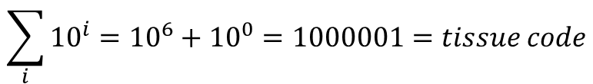
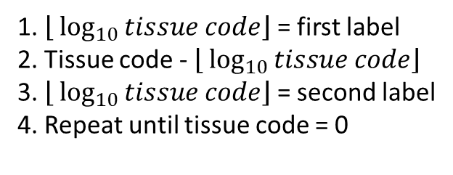
Encoding For Cluster Label
Encode
$$\sum_{i}{{10}^{i}}={10}^{6}+{10}^{0}=1000001=tissue code$$
Decode
1. $\left\lfloor \log_{10}{tissue code}\right\rfloor$ = first label
2. Tissue code - $\left\lfloor \log_{10}{tissue code}\right\rfloor$
3. $\left\lfloor \log_{10}{tissue code}\right\rfloor$ = second label
4. Repeat until tissue code = 0
Encoding what labels occur in a tile enables each and every TMA to be sequestered into separate tiff stacks in a memory efficient manner.

Slide 7
HDR Inspired Auto Exposure

Slide 8
Background
Auto exposure poses difficulties beyond what I originally imagined.
What current companies use:
Leica-predetermine
Lunaphore-predetermine
Bruker-HDR algorithm (Eva-Maria Brinkmann et al 2021 J. Phys. Commun. 5 075016)
Previous approaches of using thresholding to isolate stain pixel pools has proven to be too inconsistent to rely on.
16bit space provides sufficient dynamic range itself if the proper exp time is determined, but its too unreliable to determine it with no prior knowledge.

Slide 9
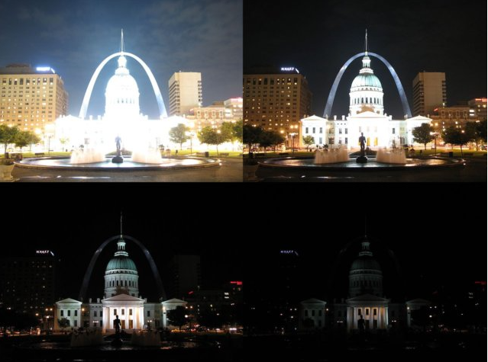
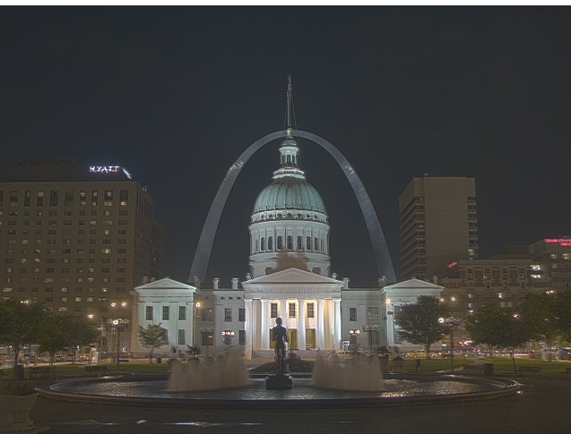
What is HDR?
Multi exposures
In traditional photography, several objects may exist in the foreground that are of interest. In this case, some may be brighter than others.
HDR in short is am attempt to increase dynamic range and help us visualize all objects of interest at one time.
Steps are usually:
Take multiple pictures with different exposure times
Align images
Convert from intensity to irradiance via CRF (camera response function)
Merge all images via weight function
Twist rendering parameters like gamma and RGB display ratios
This is highly effective in traditional photography as light in these conditions has very little associated error and we care more about visualizing and not quantifying, thus choosing a weight function that picks middling intensities makes everything roughly a similar intensity and thus can be visualized by a human at the same time looking roughly the same brightness.
Fluorescence has different constraints and goals. Especially in the context of the SpectrePlex.
SpectrePlex/Fluorescence Goals
Preserve relative intensity information
Poisson Noise limited, weigh towards bright pixels to minimize this
CRF is extremely linear, thus giving us the function apiori
All channels are gray scale (no RGB), can and should be freely manipulated independently for visualization.
No alignment needed
HDR Image

Slide 10
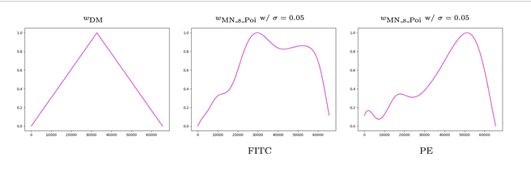
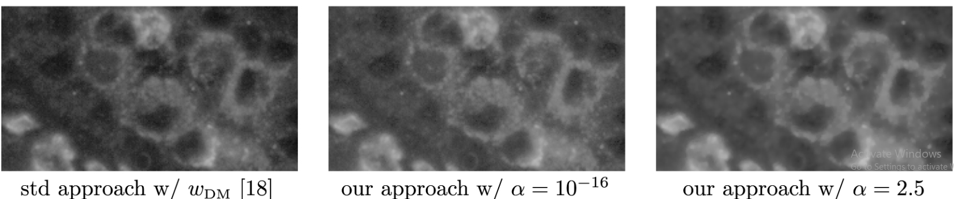
Miltenyi Biotech HDR Background
This is the first attempt to transform the HDR technique into fluorescence microscopy
TL:DR, it alters the weight function to favor higher pixel values by taking into account Poisson noise. Used stats to figure out deviations from poisson noise when making weight function. Everything else is the same.
Their approach allows objects to be properly exposed and displayed on the same image regardless of true intensity differences ala traditional HDR with no apriori knowledge of the stain.
Weaknesses
No way to verify relative intensity value accuracies and almost certainly has no negligable distortion of them
Generating image by image weight curves that can alter intensity ratios means bleached and stain must be subbed before applying algorithm. Thus cannot be run on the fly.
When compliance function is ramped up, produces artifacts in image. Some might say noise removal, but that is best left to programs like N2V as this looks artificial.

Slide 11
Our Approach
We focused on designing a version of HDR that accomplished a different goal than the milyani tech one. We wanted to preserve intensity ratios and to use HDR not as a tool to expand the image dynamic range, but instead to act like an auto exposure.
Steps:
Grab X different exposure time images
Convert to relative irradiance from intensity via the CRF
Use exp times to scale each image to what intensity is predicted to be at highest exp time taken
Use weight function that is inspired by Poisson noise and scaling inaccuracies to merge images together in 32 bit space
At end of cycle, subtract HDR version of bleached image from stained and compress to 16bit space and record 32bit value for top value in 16bit space

Slide 12
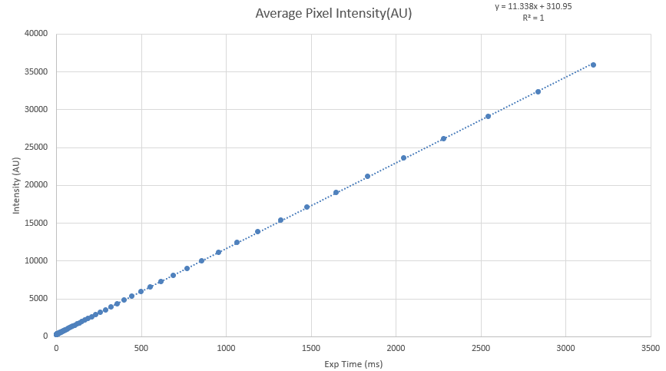
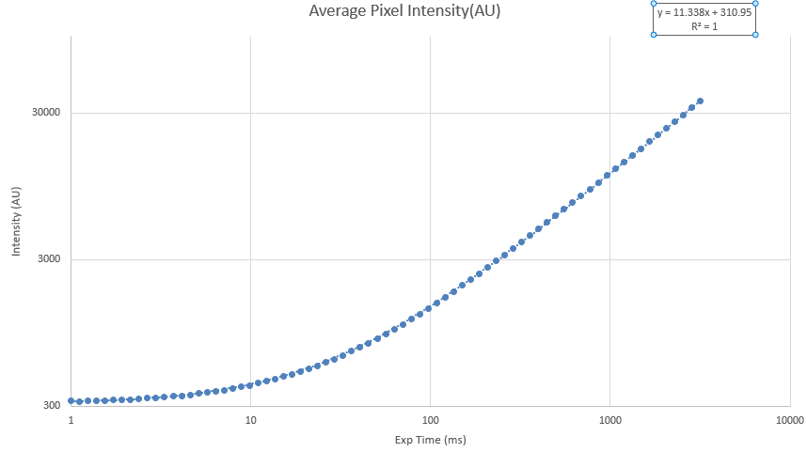
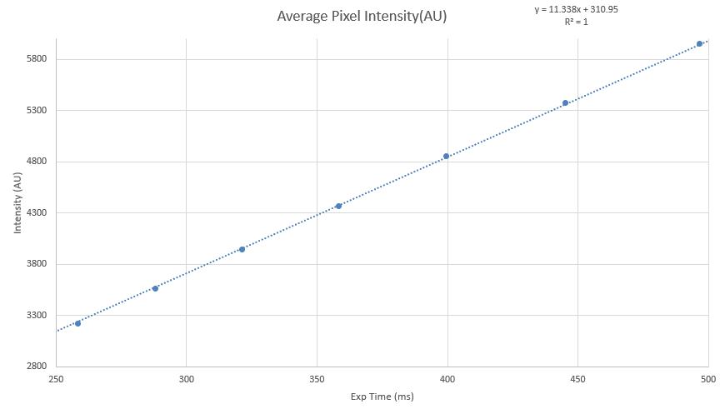
How linear is linear?
sCMOS cameras are reported to be extremely linear. If this is accurate, we know the CRF without ever needing to measure it in the image.
Below are three charts. They are all based off of images that were gathered in the exact same spot and just had different exposure times which are equal spaced in log space.
Linear linear scale
Log10 Log10 scale
Intersection zone
Log log scale is to exaggerate deviations and its clear that nothing big exists.
Intersection zone is zooming into an area that is around 4k intensity. This area is important as cameras are dual read by 12bit ADCs with different gains. They overlap around the 4k area and that overlap is used to match them ala stitching. This shows that extreme linearity still exists even at its weakest point.

Slide 13
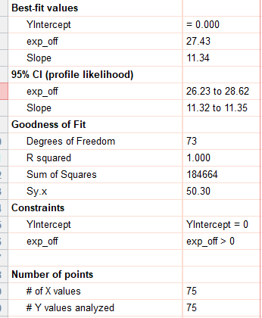
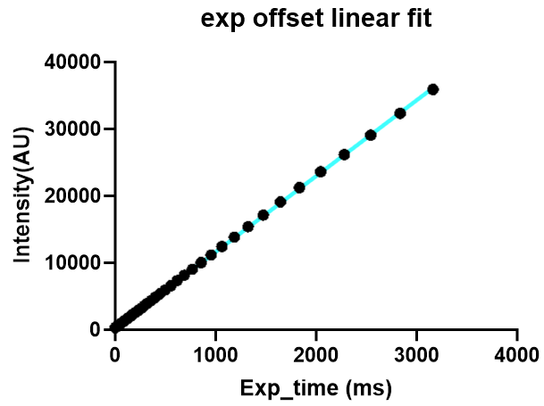
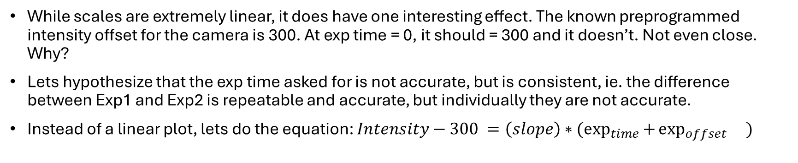
Exp Offset?
While scales are extremely linear, it does have one interesting effect. The known preprogrammed intensity offset for the camera is 300. At exp time = 0, it should = 300 and it doesn’t. Not even close. Why?
Lets hypothesize that the exp time asked for is not accurate, but is consistent, ie. the difference between Exp1 and Exp2 is repeatable and accurate, but individually they are not accurate.
Instead of a linear plot, lets do the equation: $Intensity−300 =\left(slope\right)∗(\exp_{time}{+}\exp_{offset}{})$
As a whole, exp_offset = 27.43+-1.2ms
Thus 1ms isn’t actually 1ms exposure and instead more about 28ms

Slide 14
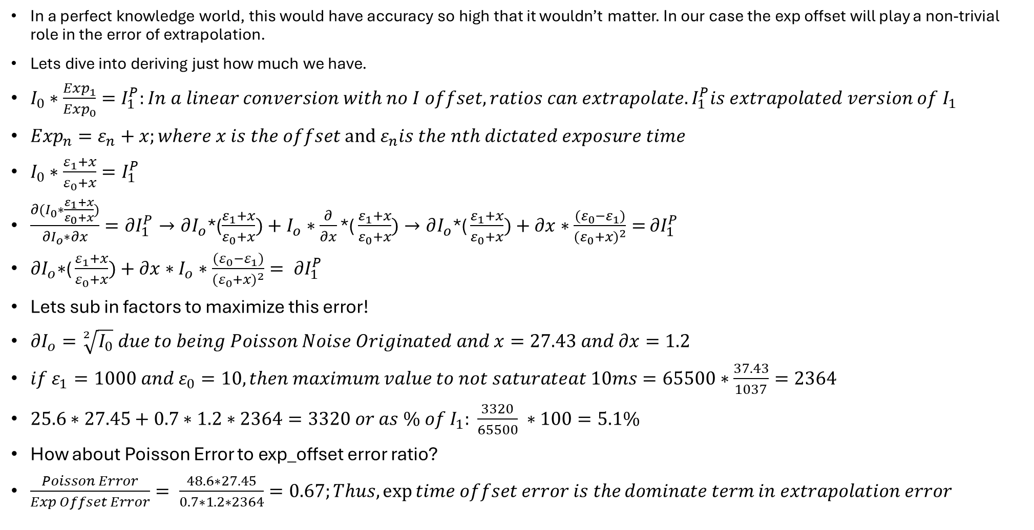
Extrapolation Accuracy
In a perfect knowledge world, this would have accuracy so high that it wouldn’t matter. In our case the exp offset will play a non-trivial role in the error of extrapolation.
Lets dive into deriving just how much we have.
$I_{0}∗\frac{{Exp}_{1}}{{Exp}_{0}}=I_{1}^{P}:In a linear conversion with no I offset, ratios can extrapolate. I_{1}^{P}is extrapolated version of I_{1}$
${Exp}_{n}=ε_{n}+x;where x is the offset and ε_{n}is the nth dictated exposure time$
$I_{0}∗\frac{ε_{1}+x}{ε_{0}+x}=I_{1}^{P}$
$\frac{∂(I_{0}∗\frac{ε_{1}+x}{ε_{0}+x})}{∂I_{o}∗∂x}=∂I_{1}^{P}→∂I_{o}$*($\frac{ε_{1}+x}{ε_{0}+x})+I_{o}∗\frac{∂}{∂x}\text{∗(}\frac{ε_{1}+x}{ε_{0}+x})→∂I_{o}\text{∗(}\frac{ε_{1}+x}{ε_{0}+x})+∂x∗\frac{{(ε}_{0}−ε_{1})}{{{(ε}_{0}+x)}^{2}}=$ $∂I_{1}^{P}$
$∂I_{o}\text{∗(}\frac{ε_{1}+x}{ε_{0}+x})+∂x∗I_{o}∗\frac{{(ε}_{0}−ε_{1})}{{{(ε}_{0}+x)}^{2}}= ∂I_{1}^{P}$
Lets sub in factors to maximize this error!
$∂I_{o}=\sqrt[2]{I_{0}} due to being Poisson Noise Originated and x=27.43 and ∂x=1.2$
$if ε_{1}=1000 and ε_{0}=10, then maximum value to not saturateat 10ms=65500∗\frac{37.43}{1037}=2364$
$25.6∗27.45+0.7∗1.2∗2364=3320 or as \% of I_{1}: \frac{3320}{65500} ∗100=5.1\%$
How about Poisson Error to exp_offset error ratio?
$\frac{Poisson Error}{Exp Offset Error}= \frac{48.6∗27.45}{0.7∗1.2∗2364}=0.67;Thus,\exp{time offset error is the}dominate term in extrapolation error$

Slide 15
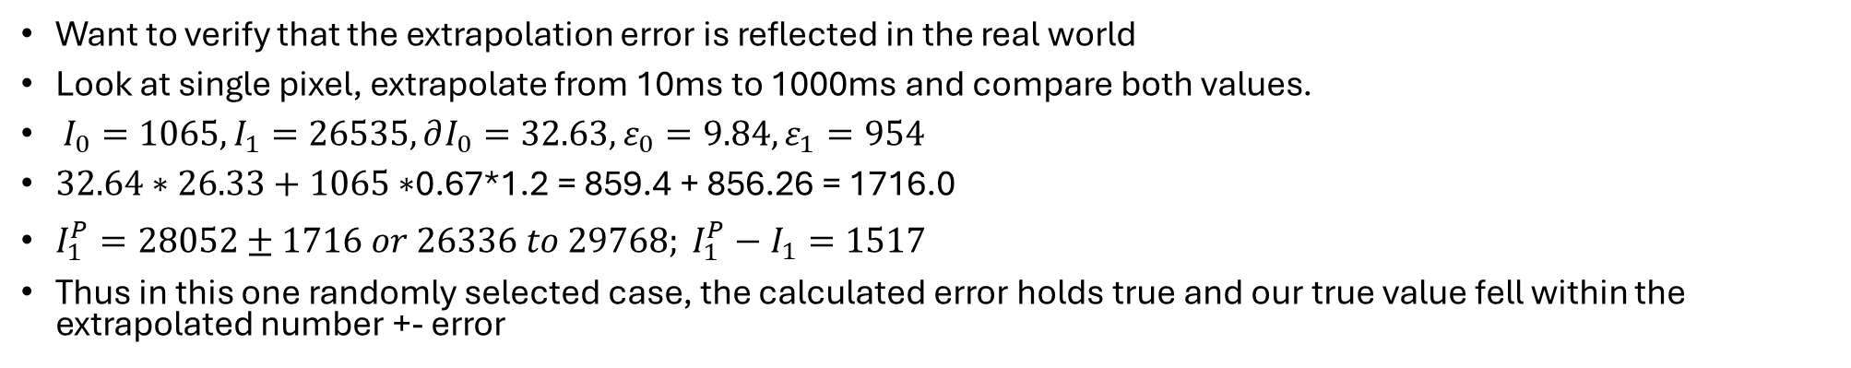
Extrapolation Test
Want to verify that the extrapolation error is reflected in the real world
Look at single pixel, extrapolate from 10ms to 1000ms and compare both values.
$I_{0}=1065, I_{1}=26535, ∂I_{0}=32.63, ε_{0}=9.84, ε_{1}=954$
$32.64∗26.33+1065∗$0.67*1.2 = 859.4 + 856.26 = 1716.0
$I_{1}^{P}=28052±1716 or 26336 to 29768; I_{1}^{P}−I_{1}=1517$
Thus in this one randomly selected case, the calculated error holds true and our true value fell within the extrapolated number +- error
This isn’t the whole story though. In this case our error was 6.5%. You might ask well that isn’t accurate enough to trust. Remember, I am trying to push the extrapolation boundaries with that one. In the real life application, our final image wont be subjugated to that. It will have a weight curve that favors pixels in the higher range where they have much higher extrapolation accuracy.
For the next part, lets generate a weight curve.

Slide 16
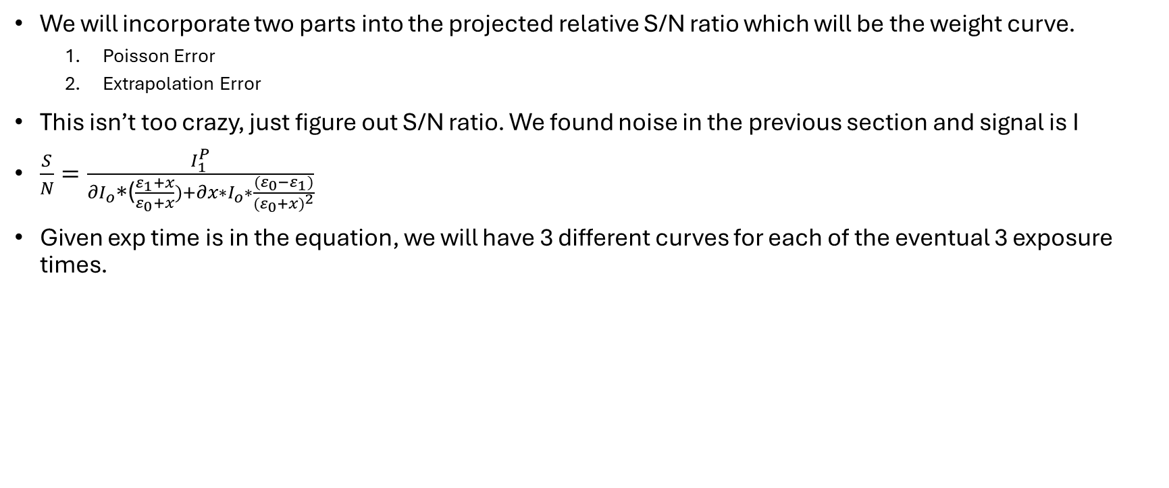
Weight Curve
We will incorporate two parts into the projected relative S/N ratio which will be the weight curve.
Poisson Error
Extrapolation Error
This isn’t too crazy, just figure out S/N ratio. We found noise in the previous section and signal is I
$\frac{S}{N}=\frac{I_{1}^{P}}{∂I_{o}\text{∗(}\frac{ε_{1}+x}{ε_{0}+x})+∂x∗I_{o}∗\frac{{(ε}_{0}−ε_{1})}{{{(ε}_{0}+x)}^{2}}}$
Given exp time is in the equation, we will have 3 different curves for each of the eventual 3 exposure times.

Slide 17
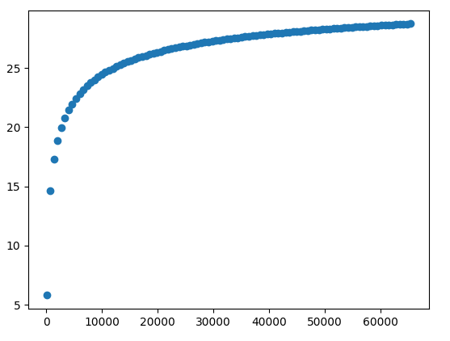
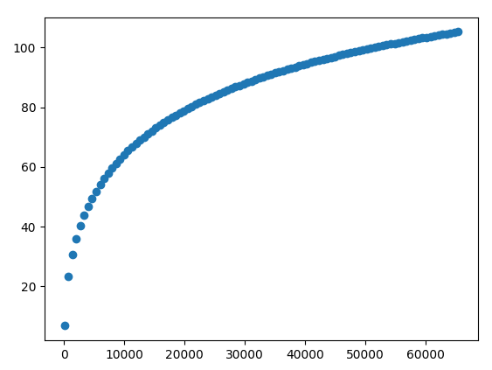
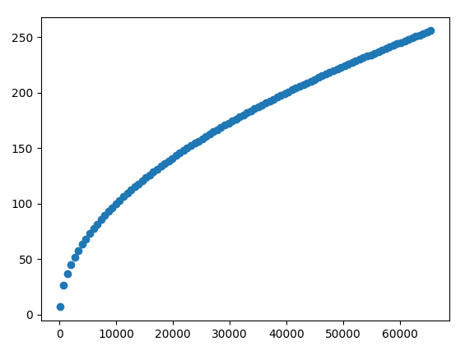
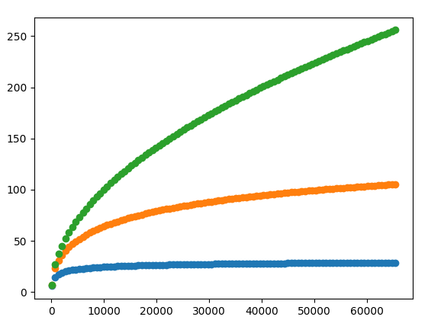
10ms
150ms
1000ms
1000ms
150ms
10ms

Slide 18
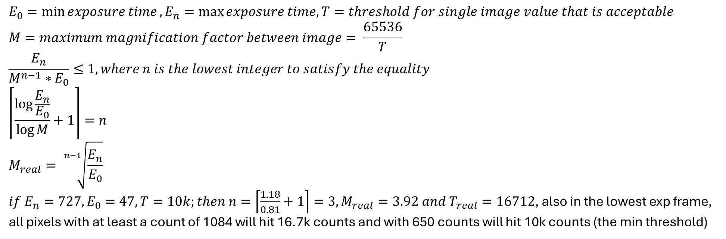
HDR exposure time choices
This is a tricky one, but really can be described by three parameters: threshold for lowest acceptable pixel value in a single image, minimum and maximum exposure time.
These parameters may not be clear at first. Lets, talk about them in more detail. The first is about establishing a baseline effective S/N for the pixel. If that is 10k counts, then for any pixels I care about in the image, I want it to be at least 10k counts in at least 1 frame and also not be saturated.
Lets explore what this process looks like.
$$E_{0}=\min{exposure time}, E_{n}=\max{exposure time, T=threshold for single image value that is acceptable}$$
$$M=maximum magnification factor between image= \frac{65536}{T}$$
$$\frac{E_{n}}{M^{n−1}∗E_{0}}≤1, where n is the lowest integer to satisfy the equality$$
$$\left\lceil \frac{\log{\frac{E_{n}}{E_{0}}}}{\log{M}}+1\right\rceil =n$$
$$M_{real}= \sqrt[n−1]{\frac{E_{n}}{E_{0}}}$$
$if E_{n}=727, E_{0}=47, T=10k;then n=\left\lceil \frac{1.18}{0.81}+1\right\rceil =3, M_{real}=3.92 and T_{real}=16712$, also in the lowest exp frame, all pixels with at least a count of 1084 will hit 16.7k counts and with 650 counts will hit 10k counts (the min threshold)

Slide 19
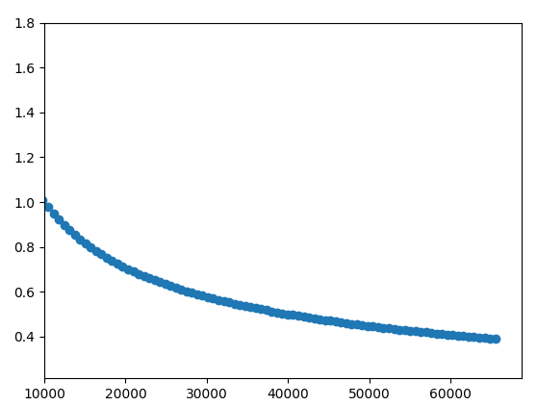
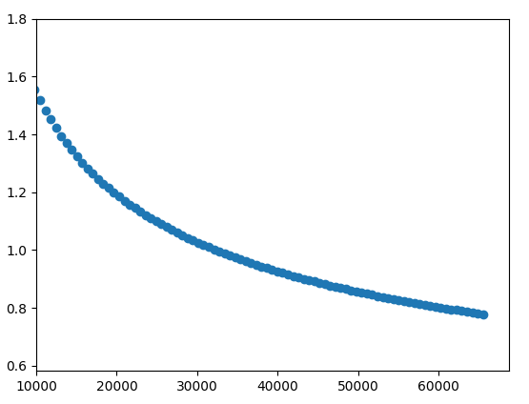
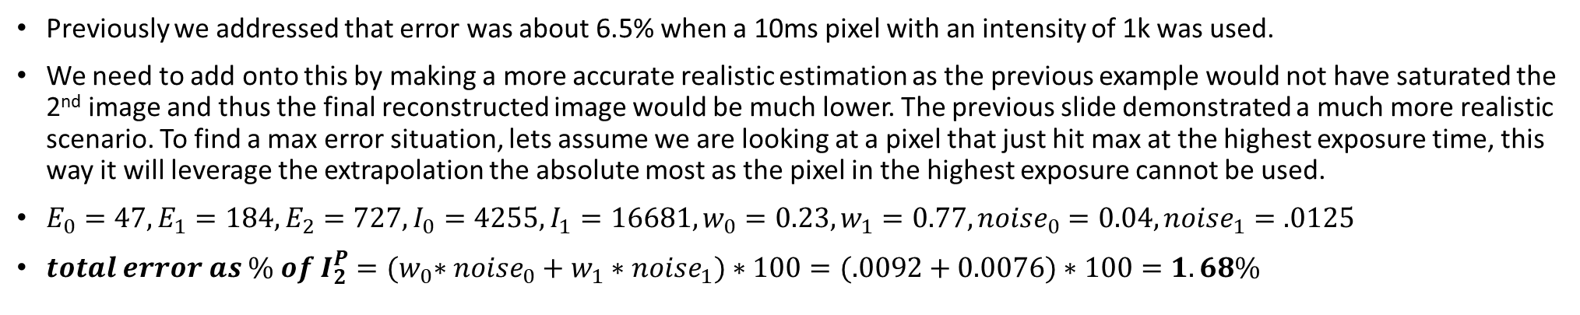
Error Revisited
Previously we addressed that error was about 6.5% when a 10ms pixel with an intensity of 1k was used.
We need to add onto this by making a more accurate realistic estimation as the previous example would not have saturated the 2nd image and thus the final reconstructed image would be much lower. The previous slide demonstrated a much more realistic scenario. To find a max error situation, lets assume we are looking at a pixel that just hit max at the highest exposure time, this way it will leverage the extrapolation the absolute most as the pixel in the highest exposure cannot be used.
$E_{0}=47, E_{1}=184, E_{2}=727, I_{0}=4255, I_{1}=16681, w_{0}=0.23, w_{1}=0.77, {noise}_{0}=0.04, {noise}_{1}=.0125$
$total error as \% of I_{2}^{P}={(w}_{0}∗{noise}_{0}+w_{1}∗{noise}_{1})∗100=(.0092+0.0076)∗100=1.68\%$
Instead of an error over 5% as in the previous framing, we can see that the realistic framing gives us a far more acceptable error.
Notice in this framing that extrapolation error is actually less impactful than poisson error. Max is around extrapolation being about equal with poissons and min is about 68% of poissons.
Poisson Only Error
P and Extrapolation Errors

Slide 20
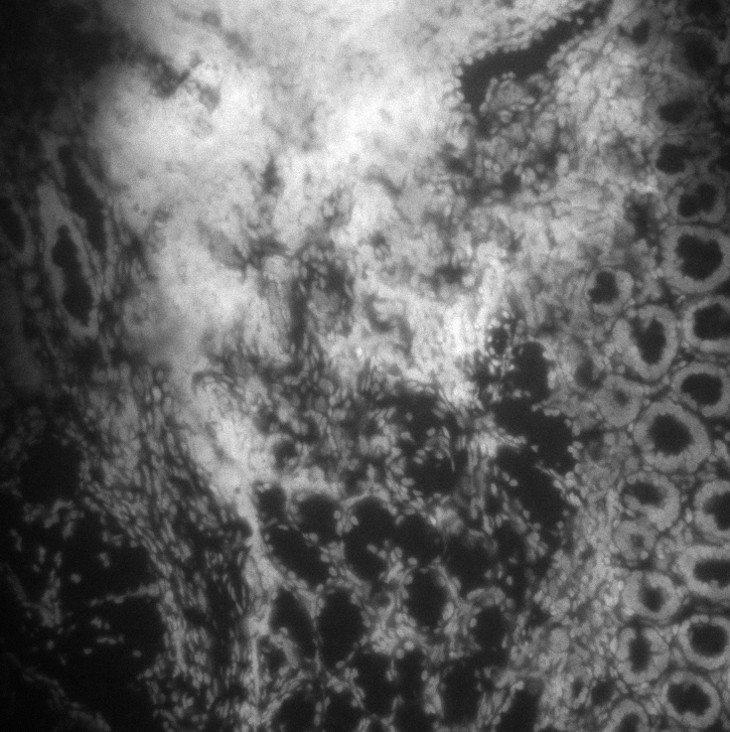


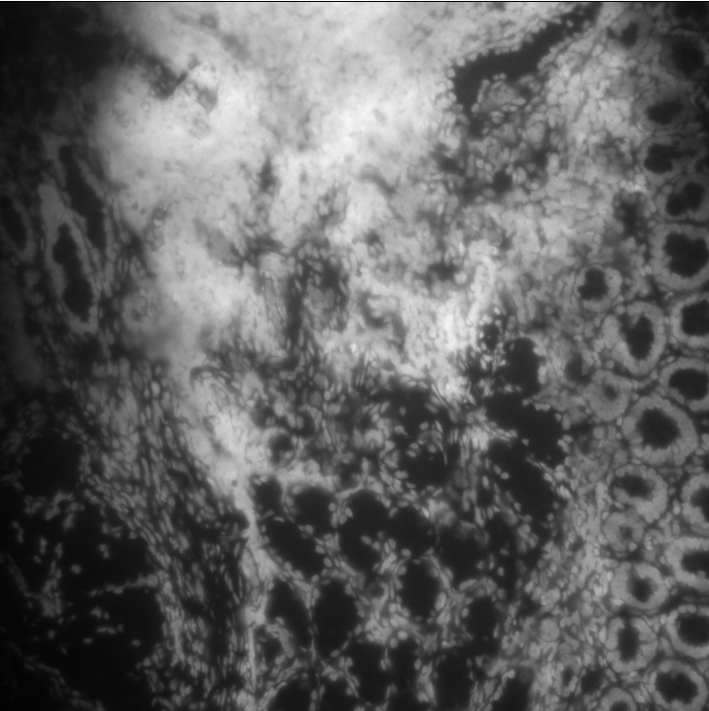
Actual Image Fusion
In this I am going to show the 3 images and what their fusion HDR product is
47ms
177ms
827ms
Nothing stands out, but hard to see details. Lets zoom in!
fusion

Slide 21
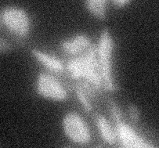
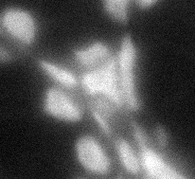
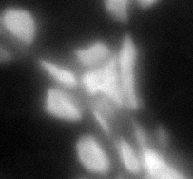
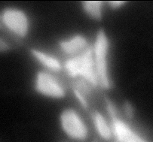
47ms
177ms
827ms
Fusion
Notice the image looks nearly identical to the 827ms image. That is as expected as it had by far the highest weight in the addition equation

Slide 22
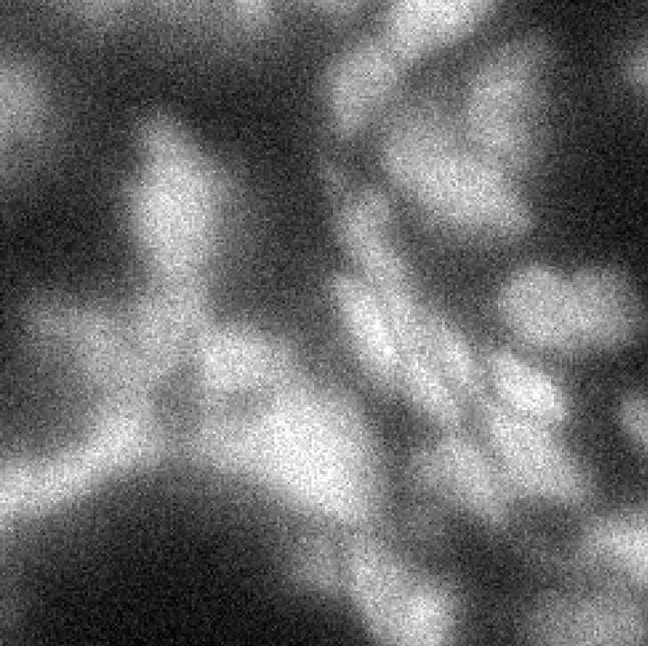
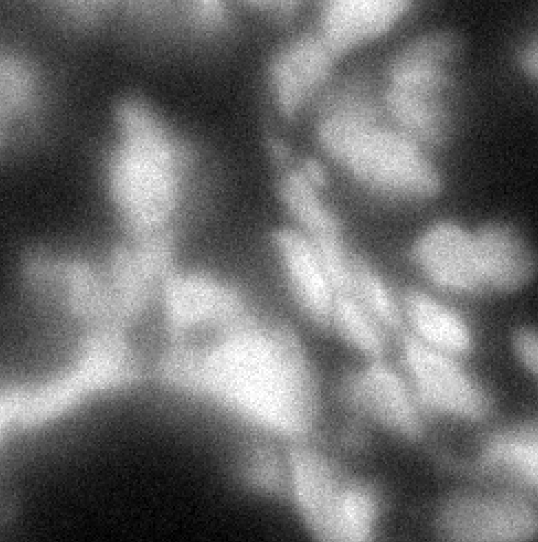
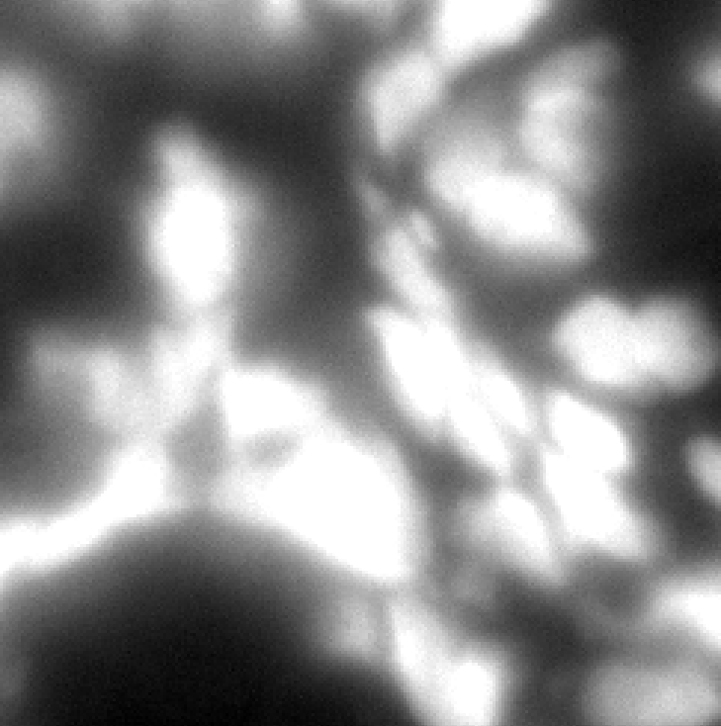
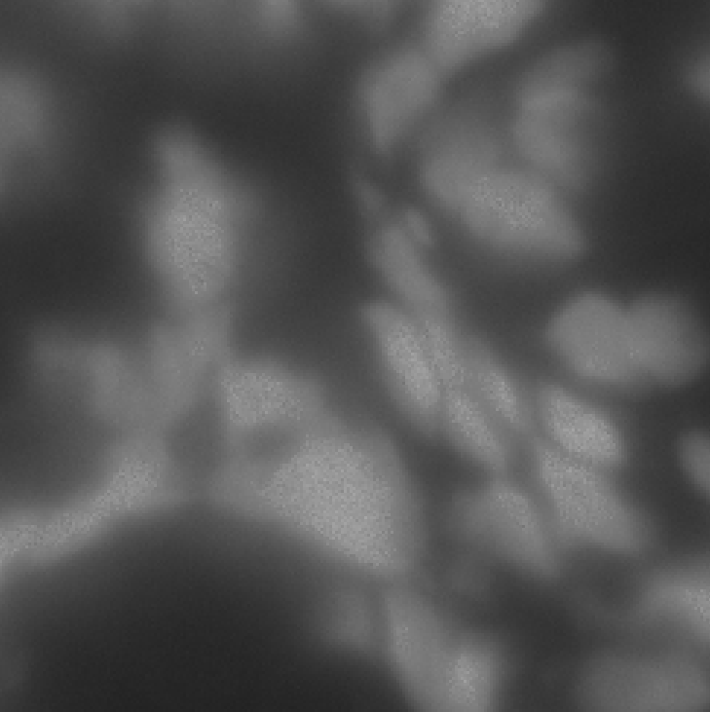
Artifacts?
Something interesting can show up when dealing with images where saturation occurs. Lets explore.
This looks patchy and like an artifact. Its easy to see how it exists though. The final exposure time produced a lot of overexposed areas. The areas that aren’t saturated have a higher count then the pixels in exposure time 2. Thus, what we are seeing is a fusion of patches that have differing S/N levels.
To explore further, lets look at line profiles across the images.

Slide 23
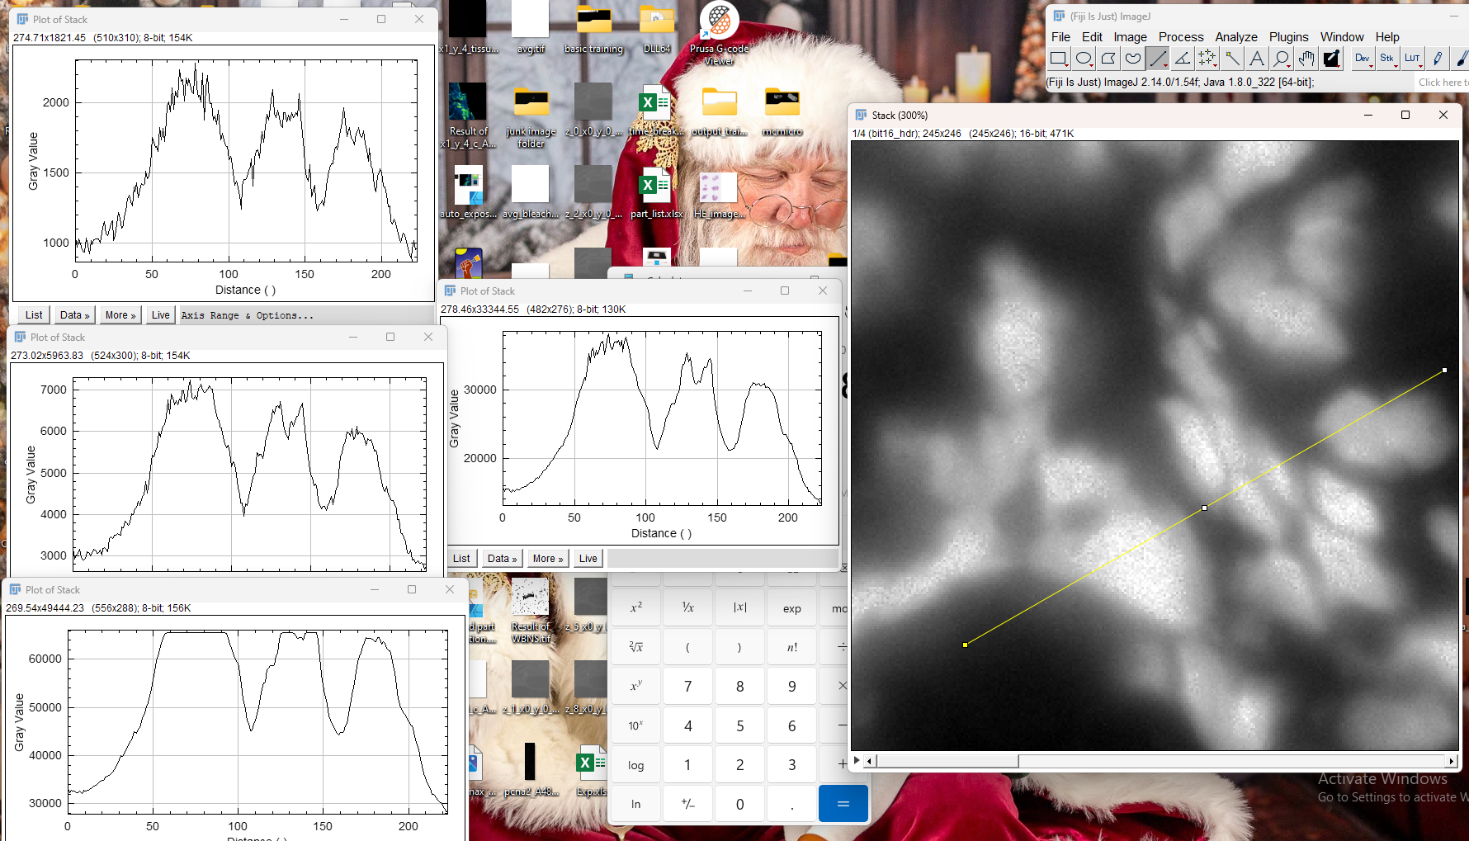
Notice how fusion results in the peak tops looking like the middle exposure and sides like the highest. While looking funny, this should result in the best accuracy of the data.

Slide 24
What Bleached Cycle matters
Should bleached image from cycle before or cycle of, be used for autofluorescence subtraction?

Slide 25
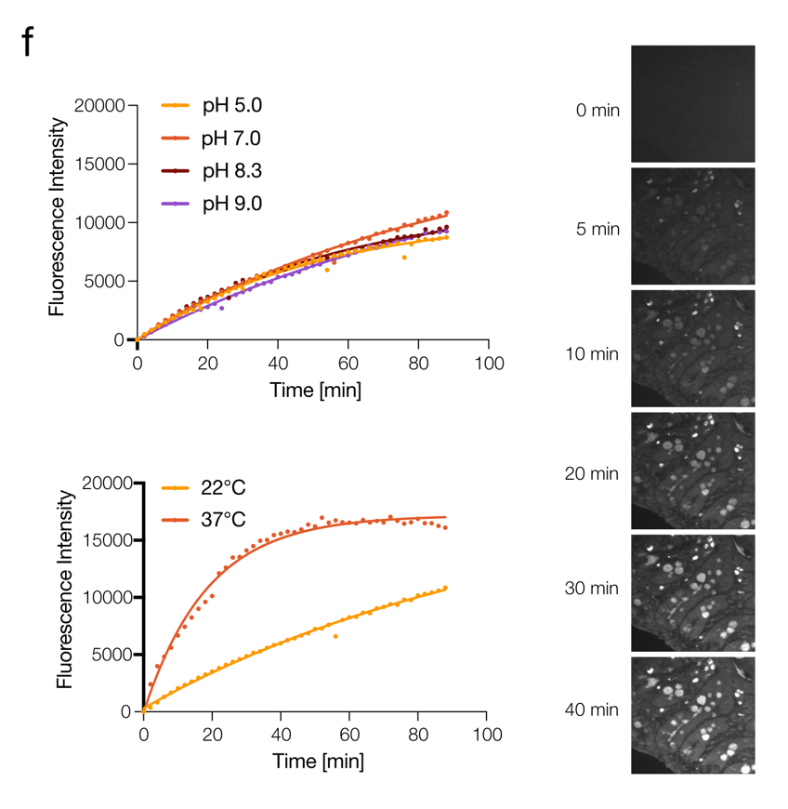
Kinetics

